Slide 1

MATCH EXPECTATION

Slide 2


Match Expectation Meeting
Objective:
Aim of Match expectation meeting is to define clearly deliveries , set mutual task list , communication layers and deadlines in order to ensure a mutual success to the project .
Attendance :
Sales Manager – eventmagix
Project Manager- eventmagix
Client Staff members

Slide 3
Match Expectation Meeting
1. Define the client’s expectations up front.
Be sure to get your clients definition of success, both short-term and long-term.
2. Establish performance objectives that closely match the client’s expectations.
  Project objectives related to time frame and budget,
  Business objectives related to how the project impacts business results
  Satisfaction objectives to ensure full satisfaction of those impacted.
3. Fully define your project scope.
We recommend three vehicles for fully defining the scope:
  The deliverables list,
  The task list a
  The business area diagram.
4. Hold regular update / periodical meetings with a focus on performance against expectations.
5. Document changes to scope and objectives.
Implement a formal change control process to ensure that changes in scope or performance outcomes are understood and in agreement.
6. Provide an engagement close letter at project completion.
The engagement close letter documents performance against scope and performance objectives.

Slide 4
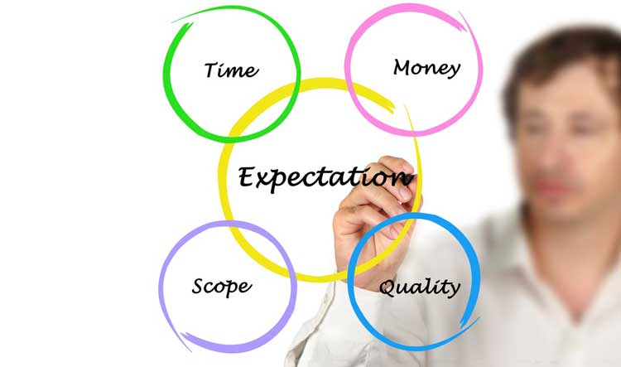
Meetings Goals
Set Ground Rules
Partners onboarding
Match expectations
Review Deliveries
Set timeline of operations
Agree upon working and communication tools
Set periodical meetings & Milestones

Slide 5
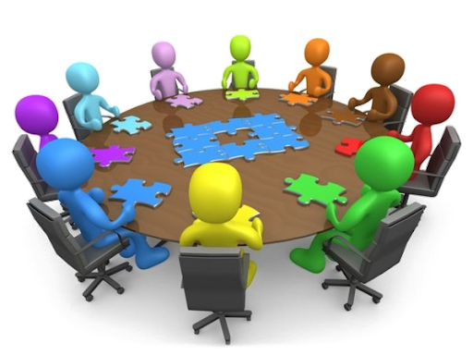
Project Milestone Meetings
Kick off & Match Expectations
Periodical Meetings
Pre event Briefing
Debriefing +Report

Slide 6

Project Communication Layers
Microsoft Teams
https://projects.ver.us

Slide 7
